Slide 1
SOCIAL NEED

Slide 2
What is Social Need? And Types of Need
A well-established and widely-used model for thinking about the ways that needs are identified is Jonathan Bradshaw’s ‘taxonomy of social need’ (1972, reproduced in Cookson et al., 2013). It gives us some further angles on the social work diamond, about the relationships between service users and social professionals in saying what a person’s needs are. Bradshaw distinguishes between four ways of identifying need:
• Felt need. • Expressed need. • Comparative need. • Normative need.
Felt need is the need that individuals and groups perceive for themselves – they feel hungry, they feel the need for more money, better jobs, warmer homes, better schools. The difficulty of relying on felt need as the test of whether someone really is in need or not, is that people have very different perceptions about their own needs.

Slide 3
Some felt needs become expressed needs, when they are turned into a demand – ‘The children round here need a playground’. But not all felt needs are expressed – people may keep quiet out of a sense of shame, or because they are afraid of the consequences of asking, or because they cannot imagine anything being any different – what’s the point of asking, that’s just the way things are.
Comparative need is identified by comparing the situation of some people to that of others – so, children in some schools do not achieve as good exam results as those in others, adults in some neighbourhoods have poorer health than those in others. But how to deal with those differences? The children may need extra help, or their parents, or their teachers.

Slide 4
Normative need is need decided by professionals and experts, in accordance with their norms and standards. For example, experts might decide what sorts of things people need for an adequate lifestyle, and then calculate the level of income this requires.

Slide 5
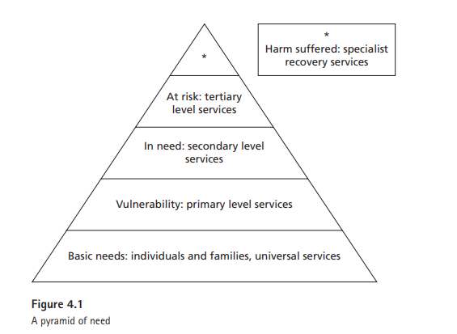

Slide 6
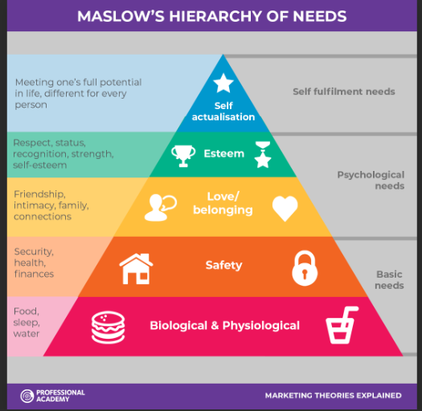
Maslow’s Hierarchy of Needs
Self-actualizing people are self-aware, concerned with personal growth, less concerned with the opinions of others, and interested in fulfilling their potential.
"What a man can be, he must be," Maslow explained, referring to the need people have to achieve their full potential as human beings.

